Slide 1
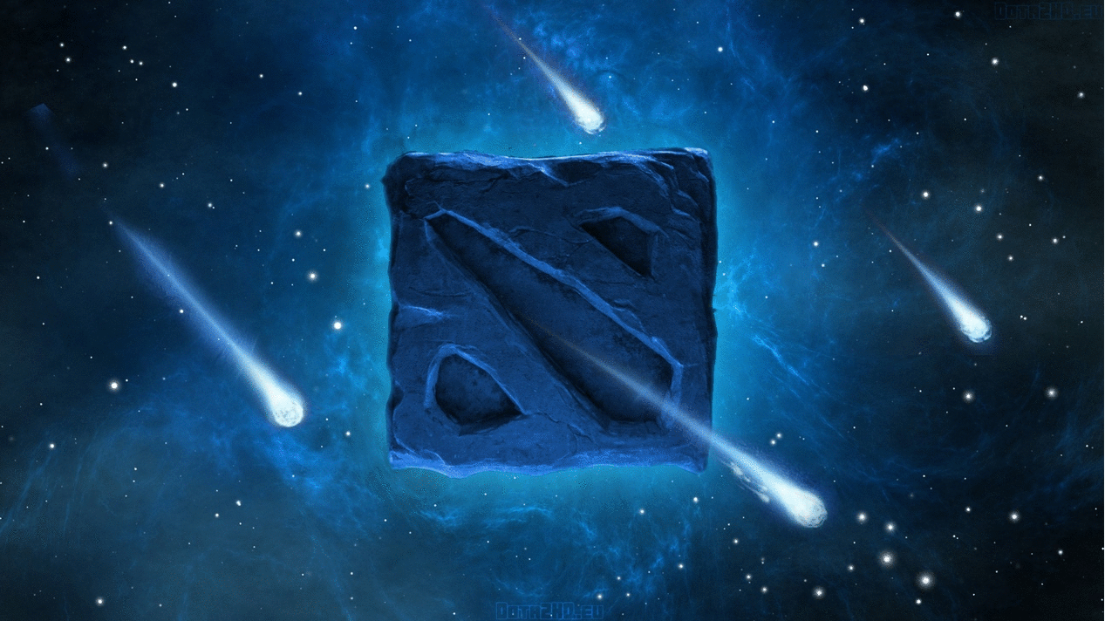

Slide 2

Dota 2 is an Action RTS computer multiplayer team game developed by Valve Corporation. The game was announced on October 13, 2010 and released on July 9, 2013 for Windows, and on July 18, 2013 for Linux and OS X. The game is distributed under the Free to Play model. Dota 2 is the implementation of the famous Defense of the Ancients map for Warcraft III: The Frozen Throne, based on the Aeon of Strife map for StarCraft.

Slide 3
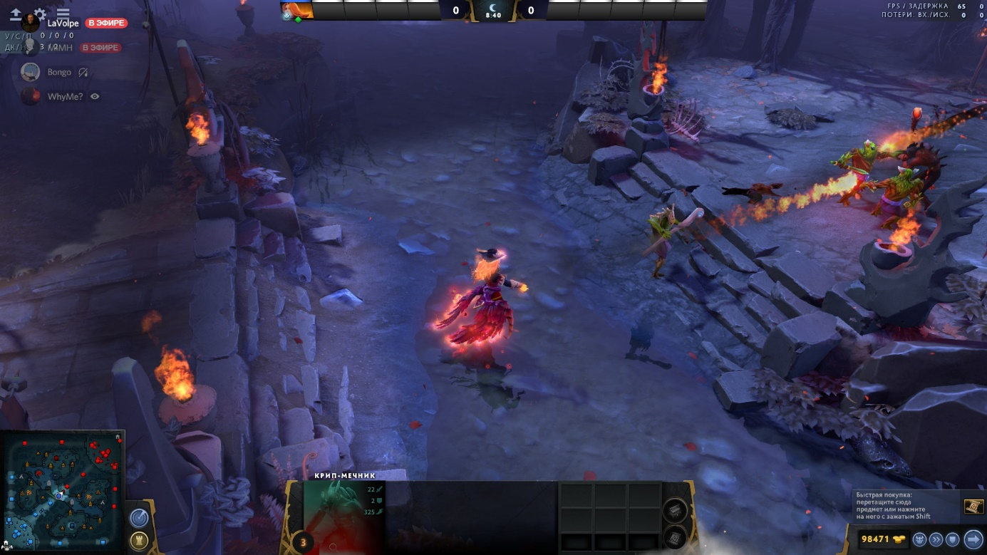
Game process
Dota 2 is a combination of RTS and RPG. Players are divided into two competing teams (Forces of Light and Forces of Darkness), each of which contains up to five players. The main goal of the game is to destroy the enemy Fortress and protect your own. Fortresses are protected by three towers on each side. Each player controls a hero, a strategically powerful unit with unique abilities and characteristics that improve over time. The hero can gain experience to increase his level, earn gold, buy and collect items that enhance it. Each player constantly receives a small amount of gold, and also earns it by killing creeps, heroes and destroying buildings.
Dota 2 has a strong emphasis on tactics and teamwork, and strategy is often tied to speed gains, optimal item selection, and ability enhancement order.

Slide 4
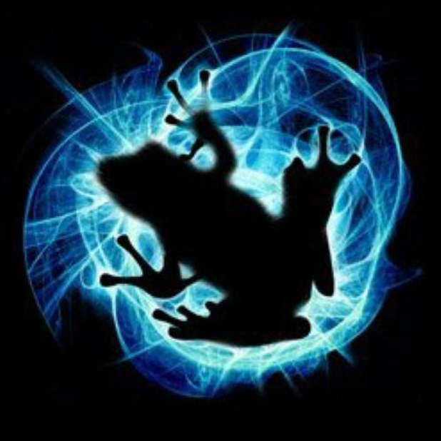
Development
IceFrog , the lead developer for the original Defense of the Ancients , was hired by Valve Software in 2009.
The beta test began in 2010 and officially ended in July 2013 just after The International 2013 , when the Windows client was officially released with the queuing system implemented. Mac and Linux clients were released a week later. Dota 2 is powered by the Source 2 engine and repeats some small details from the original DotA to preserve the gameplay
The identity of Icefrog is still unknown

Slide 5
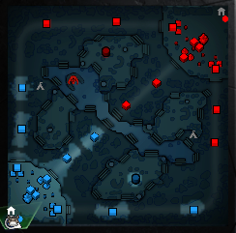
Map
The map is the playing field of all Dota 2 matches. It consists of two sides, one of which is occupied by the Forces of Light , and the other - by the Forces of Darkness . To win, players must destroy the enemy fortress , an important building in the center of each team's bases. The map is duplicated in the interface by a mini-map . It is also important to know that there is only one map in the game, but custom games can use maps created by the community.

Slide 6
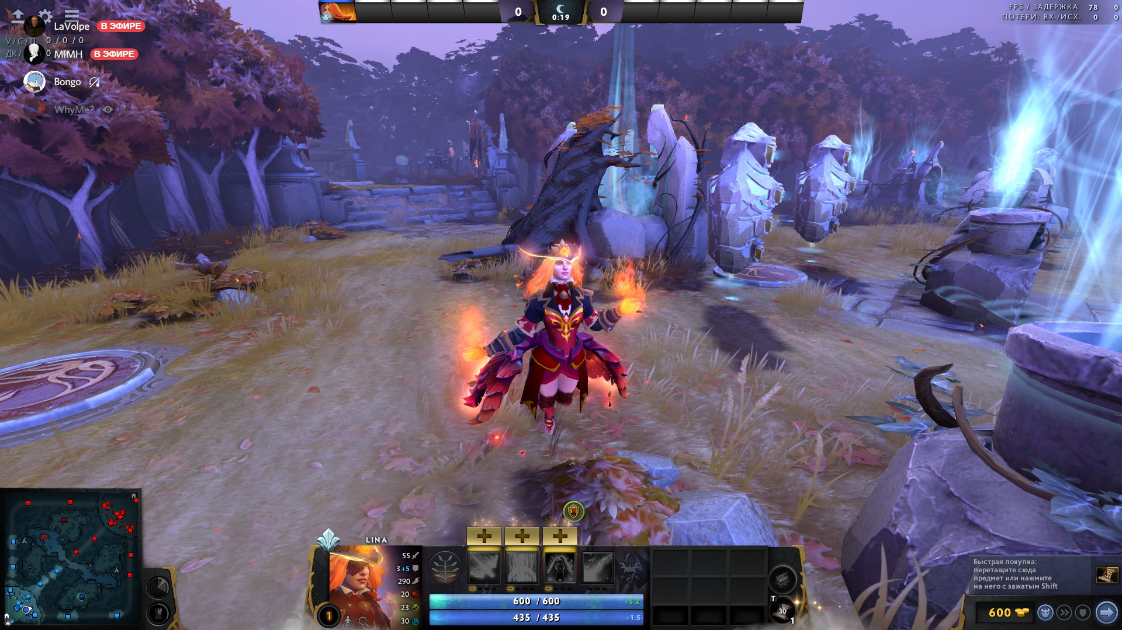

Slide 7
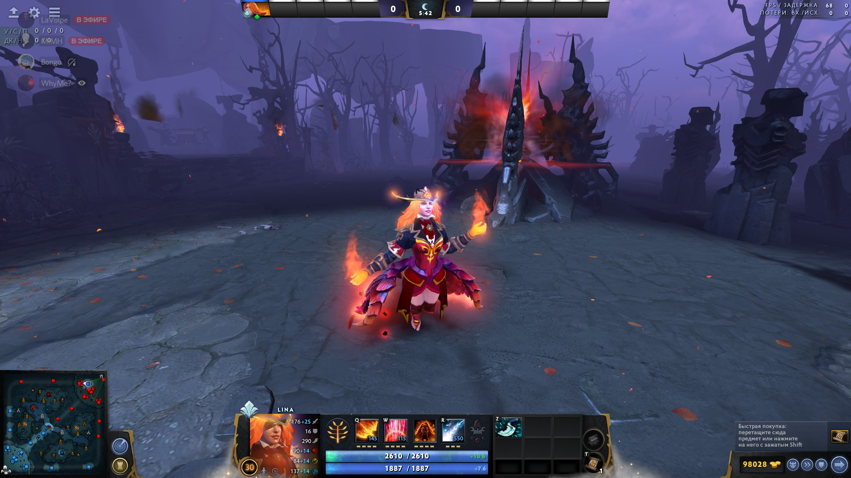

Slide 8
Heroes
All heroes are unique characters in Dota 2. At the beginning of each game, players are divided into two teams of five, and then they choose a hero. Each player controls his own hero and the units that the heroes control (for example, neutral creeps under the influence of Holy Persuasion ).
The hero gains experience when an enemy unit is killed near him. All heroes start the game at the first level and, gaining experience, increase it. With each new level, the hero's attributes increase and new abilities are learned.
Heroes are divided into three categories : Strength, Dexterity, and Intelligence
There are currently 122 playable heroes in Dota 2. 112 of them were in the original Dota, however Monkey King , Dark Willow , Pangolier , Grimstroke , Mars , Void Spirit , Snapfire , Hoodwink , Dawnbreaker and Marci were released after their transfer .

Slide 9
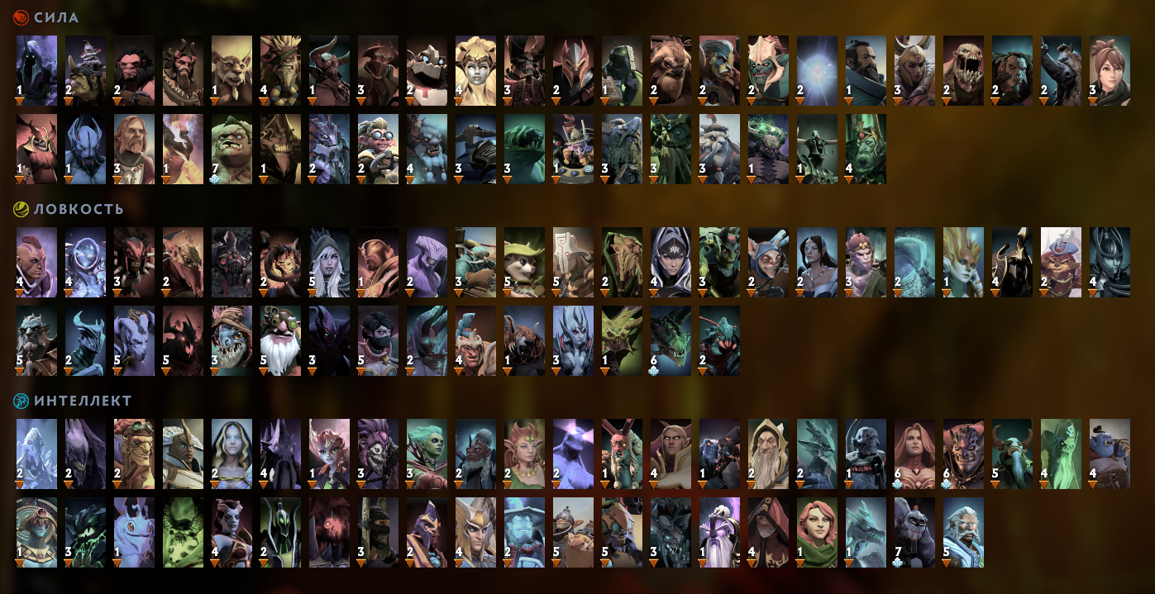

Slide 10
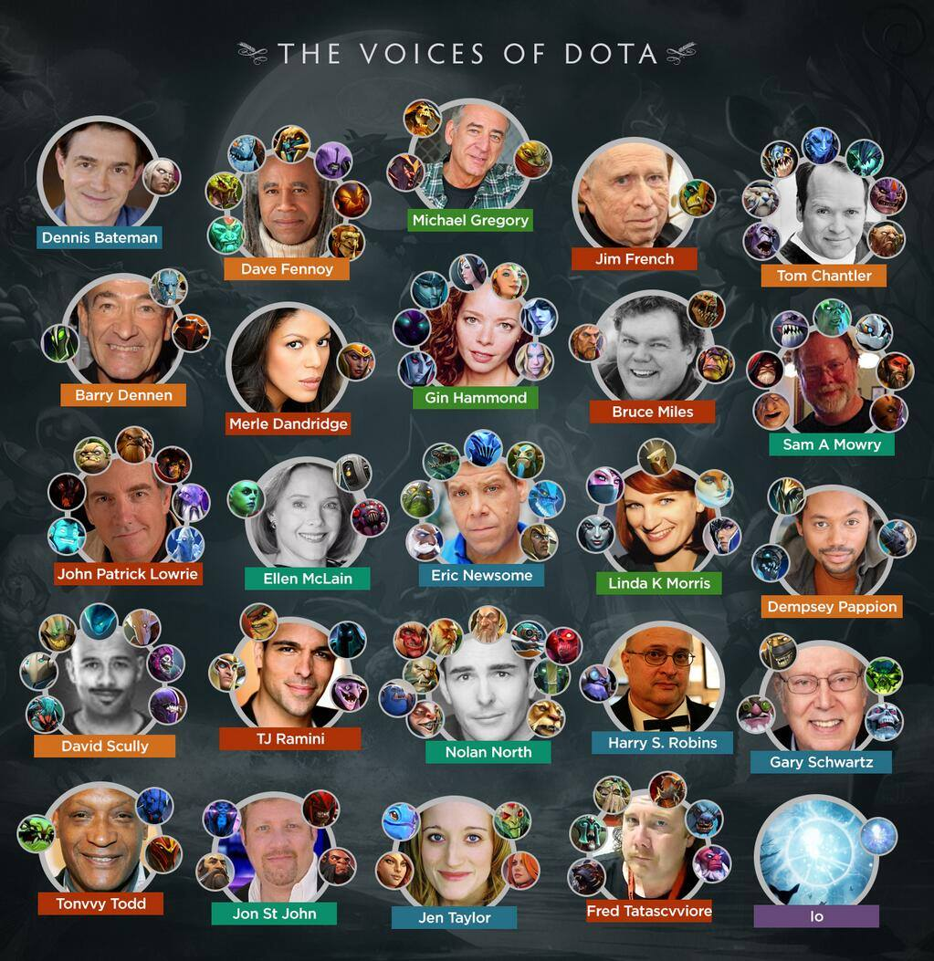

Slide 11
Items
Items are used to give the hero new abilities; to increase the experience gained or restore health and mana. Items are sold in the main shop, sideline shops or secret shop , more powerful items require some basic items and a recipe. Items take up space in the hero's inventory, which consists of 6 slots in the main inventory and 3 slots in the knapsack. Items in the knapsack are inactive and do not give passive characteristics. When you move items from the knapsack to the inventory, they will become active only after 6 seconds.

Slide 12
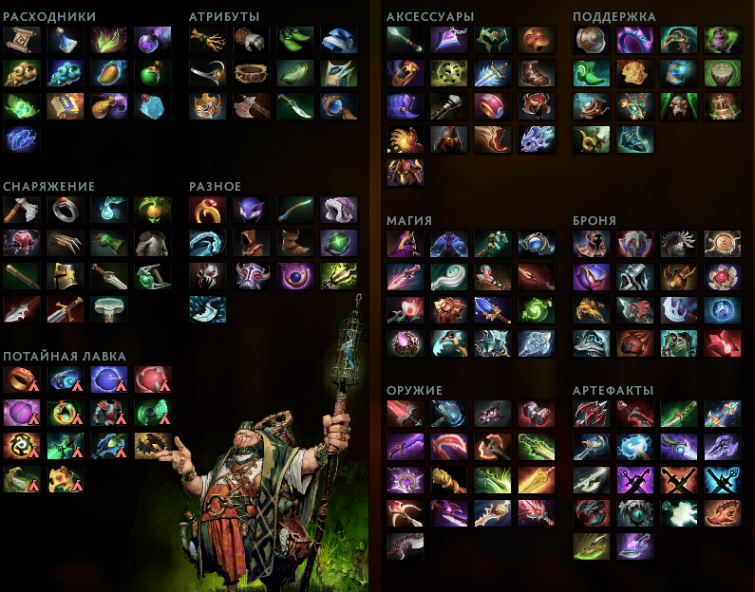
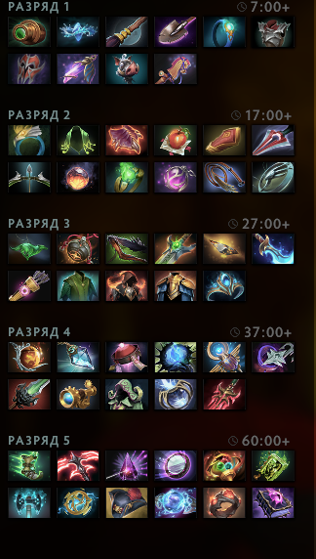

Slide 13
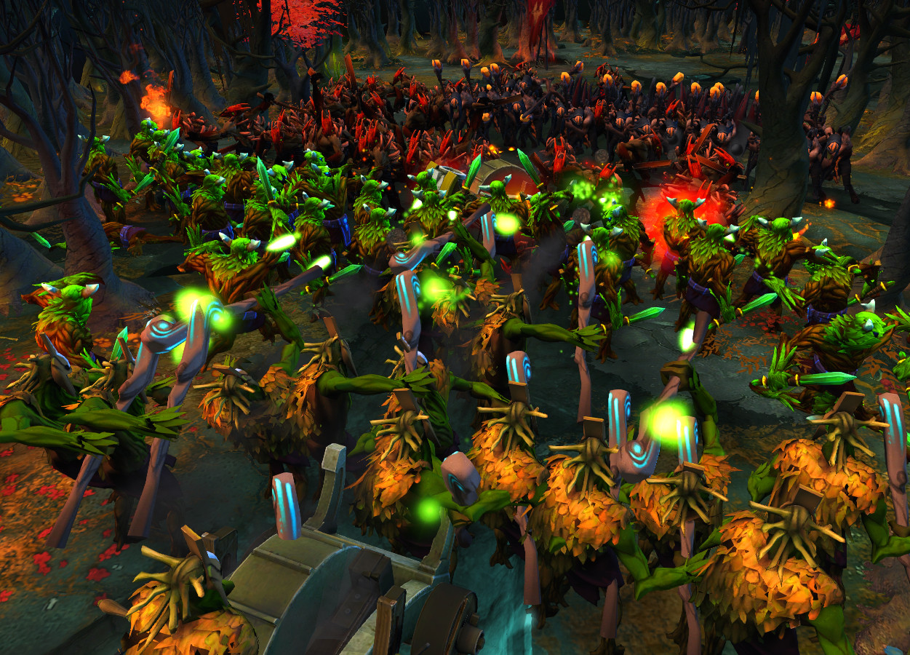
Gold and experience
Gold is issued periodically, but in large quantities it can be obtained by killing enemy units (creeps, towers, enemy heroes). Depending on who was killed, gold can be transferred to the assassin (reward for the creep) or his team (towers, barracks, couriers and Roshan ).

Slide 14
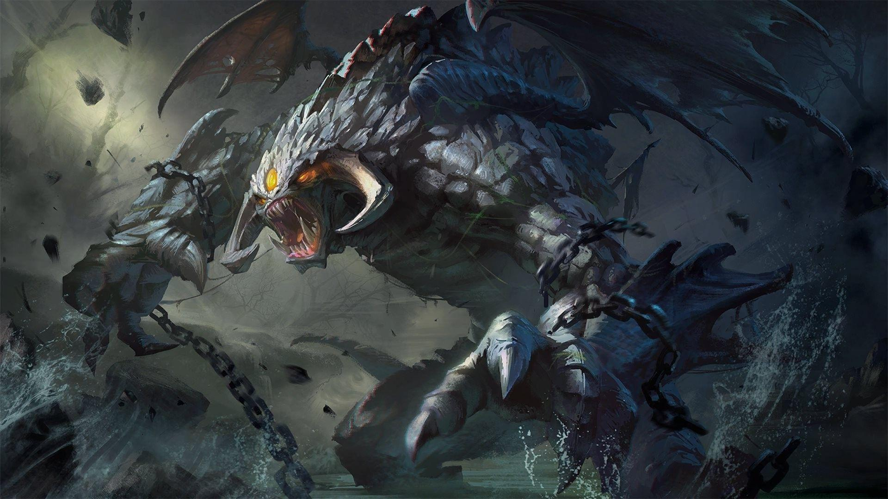

Slide 15


Slide 16
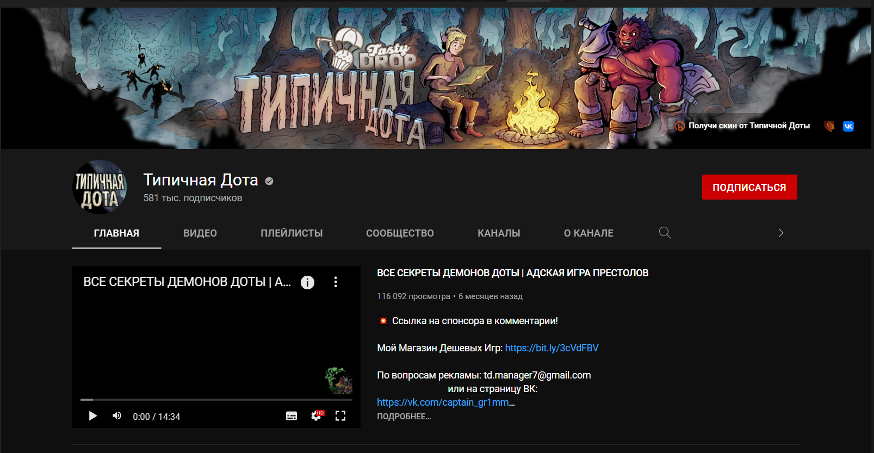
I can say that Dota has its own culture in some way
each character has its own story. For example, ‘Typical Dota’ – youtube channel tells the story of each Dota hero and something interesting facts about them.

Slide 17
Arts

Slide 18
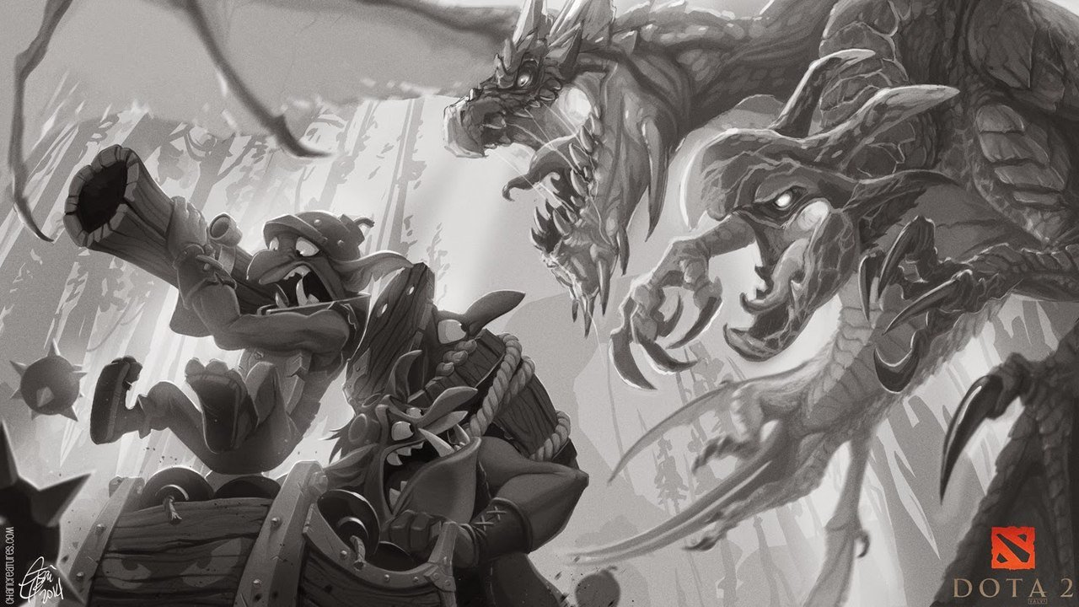

Slide 19
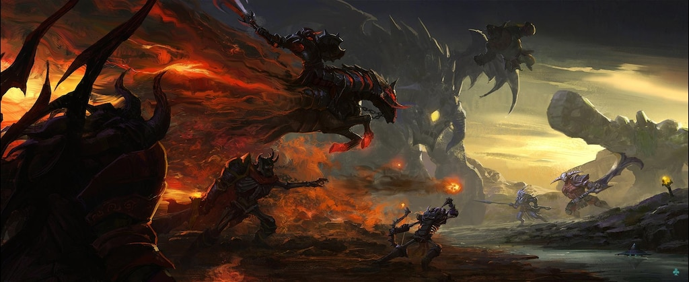

Slide 20
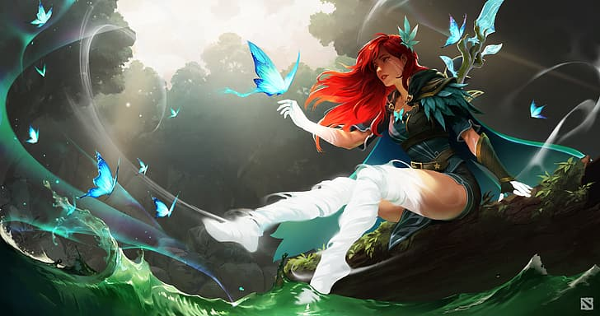

Slide 21
